Slide 1



TWIC - A TWITTER CLONE
Presenters:
SHAREYAR.F
M.MUBASHIR
M.HASAN
A.HANNAN
TALHA.I

Slide 2
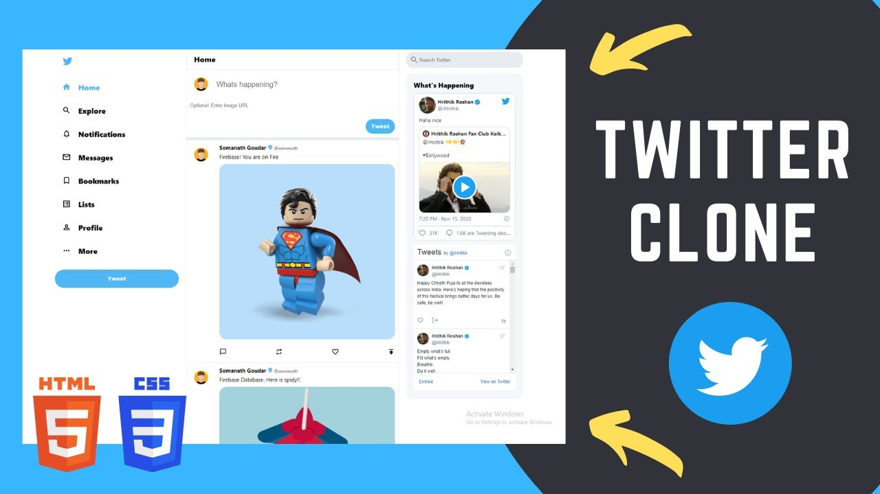
Introduction
This project will build a communications website similar to the popular application “Twitter.” This will be called “Twitter Clone” or Twic for short. Twic will allow interested persons to use the website on their PC and/or mobile device.
The service allows a user to post short updates and subscribe to updates by specific persons. The list of subscribers will be searchable by name and subject.
2

Slide 3






FRAMEWORKS USED:

Slide 4
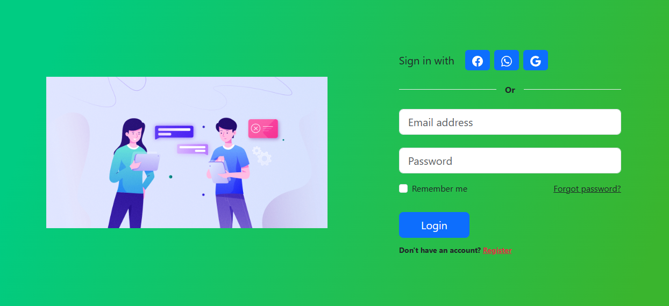
LOGIN PAGE

Slide 5
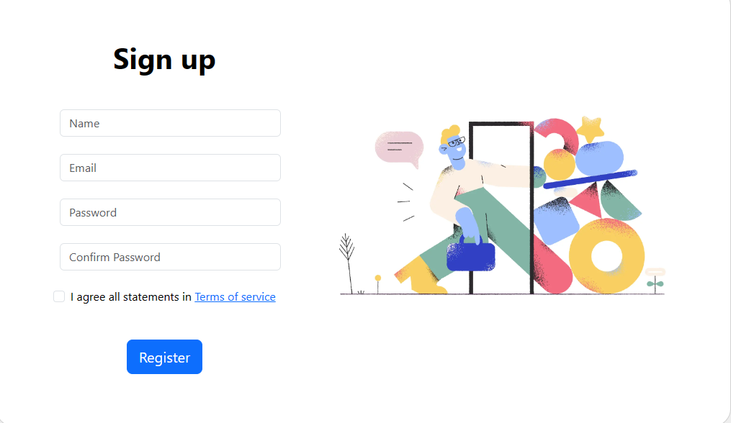
SIGNUP PAGE

Slide 6
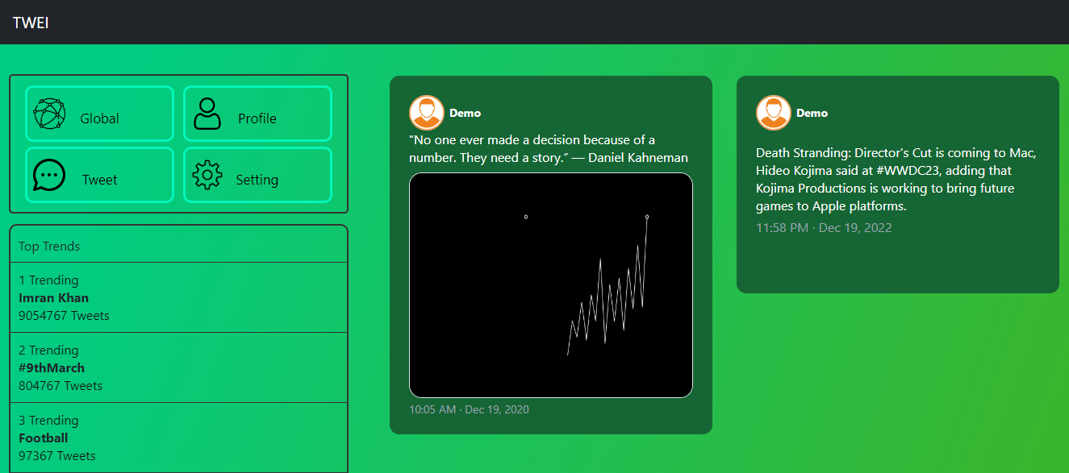
USER-HOME

Slide 7
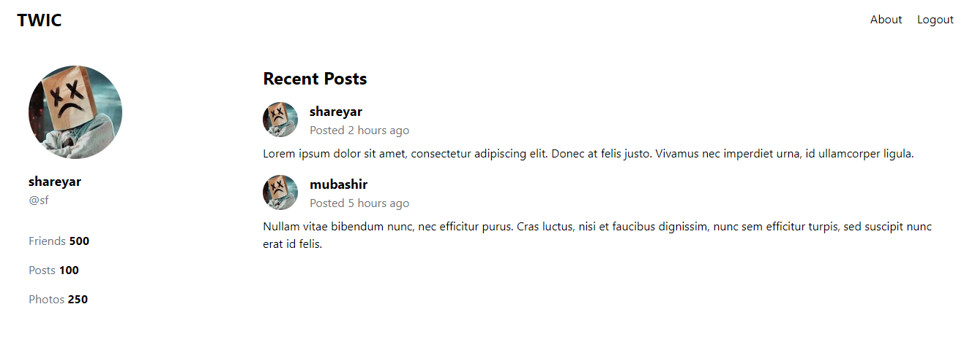
USER PROFILE

Slide 8
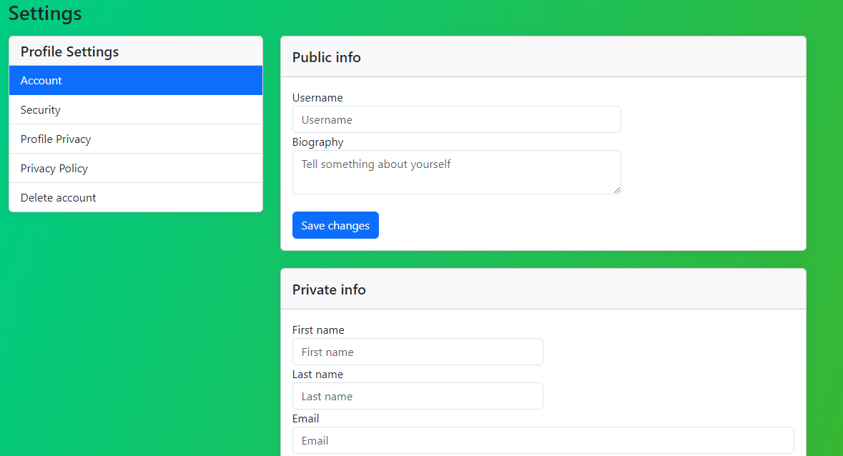
SETTINGS – MAIN PAGE - ACCOUNT

Slide 9
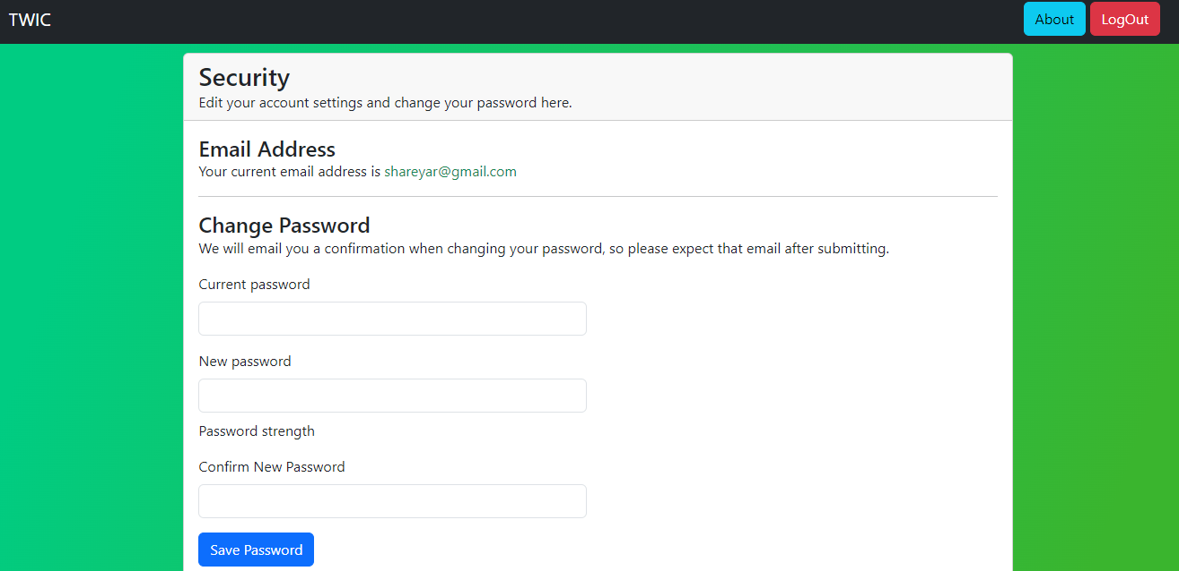
SETTINGS – 2ND TAB - SECURITY

Slide 10
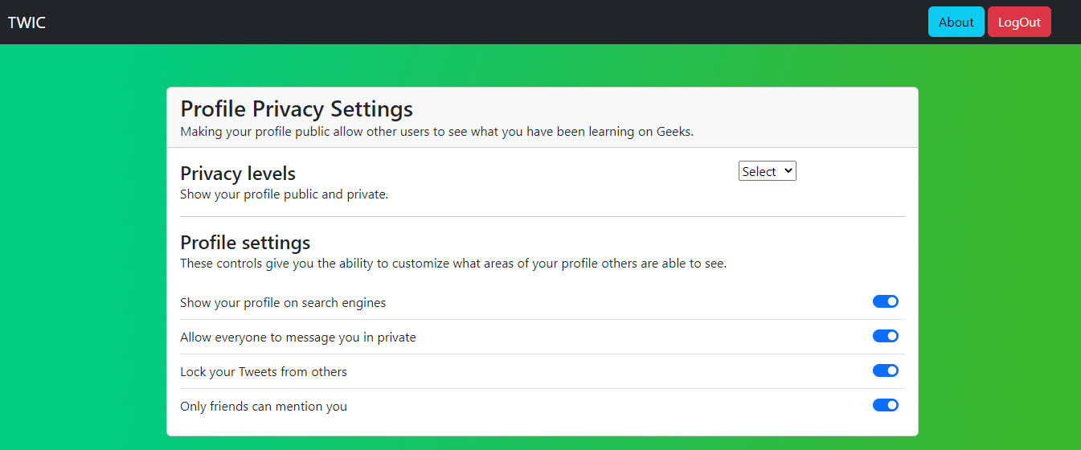
SETTINGS – 3RD TAB – PROFILE PRIVACY

Slide 11
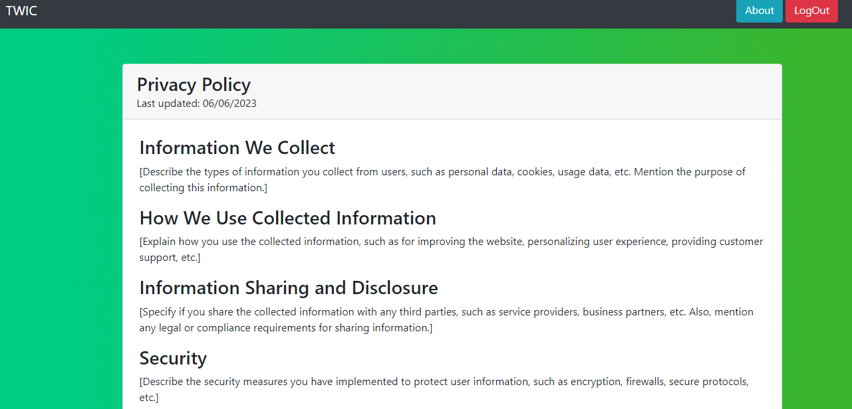
SETTINGS – 4TH TAB – PRIVACY POLICY

Slide 12
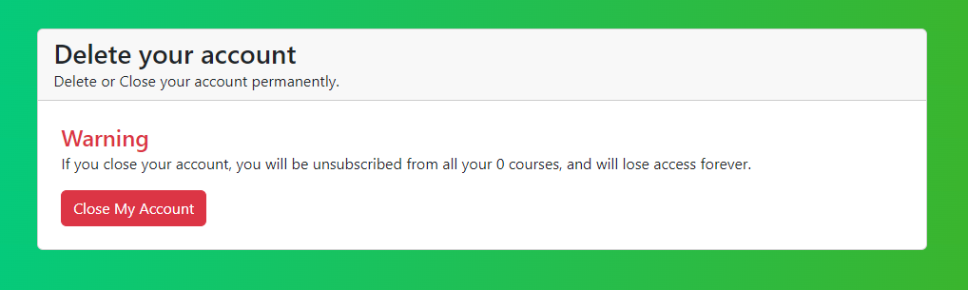
ACCOUNT – 5TH TAB – ACCOUNT DELETION

Slide 13




Thank you FOR LISTENING ☺

